Slide 1
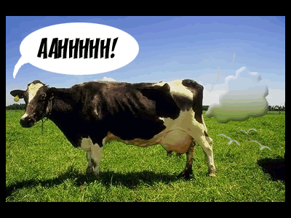
Why Do Cows Burp So Much?
Katherine Davis, Finn Schafer, and Sarah Yvon

Slide 2
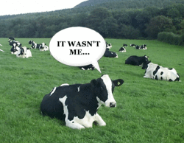
Lesson Overview
Introduction to cattle anatomy: what’s in that cow?
Little helpers: the gas factories
Tying it all together

Slide 3
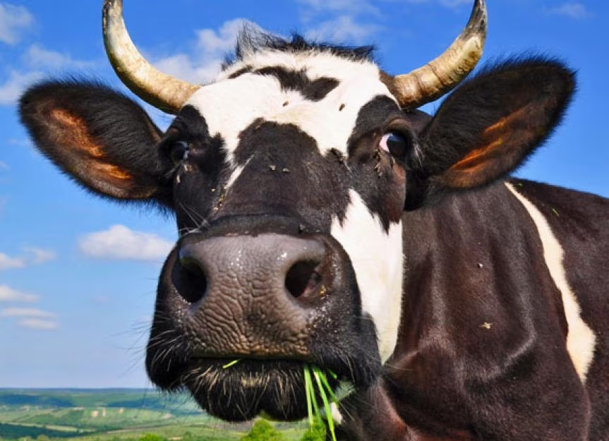
The Inside of a Cow
Cattle are called “ruminants”
When we swallow, food goes into the stomach
When cows swallow, it’s a little more complicated…
Cows have four chambers in their abdomen: the reticulum, omasum, abomasum, and the rumen. Each one has a specific function

Slide 4
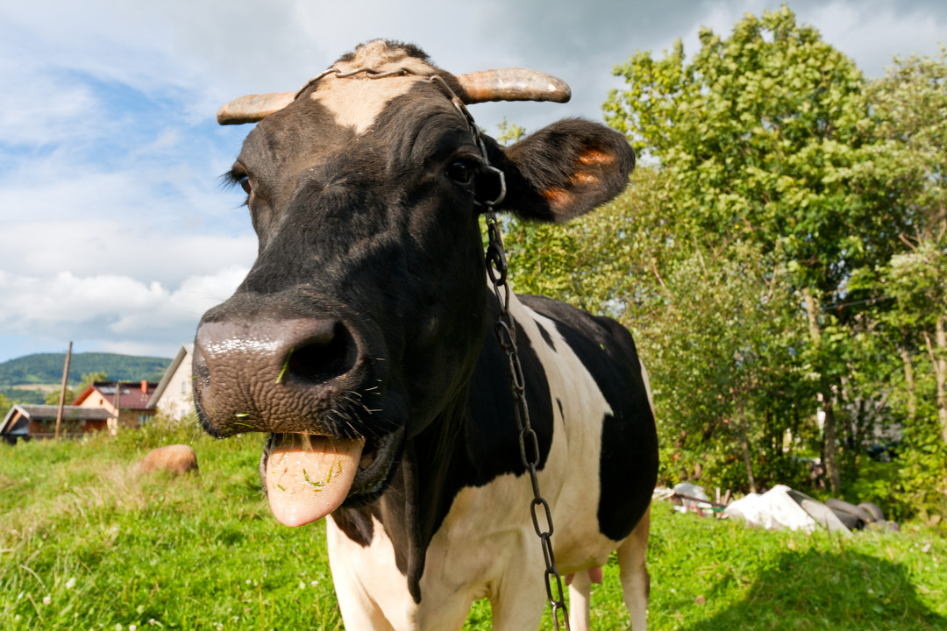
The Rumen: Where the Magic Happens
The rumen is a very large chamber for food storage and processing
It can be called the “fermentation vat” due to the presence of little organisms called microbes that help break down food (more on that later…)
When cows chew cud, they’re chewing food that’s come up from the rumen!

Slide 5
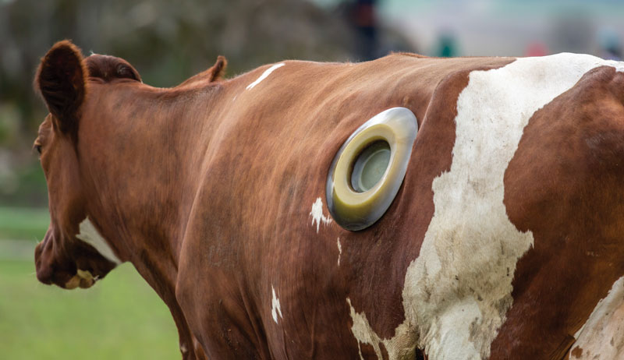
The Rumen
This cow has a cannula (think of it like a window on a house) in its rumen that allows access to the inside of the rumen. Think about it… would you stick your hand in a cow’s rumen?

Slide 6
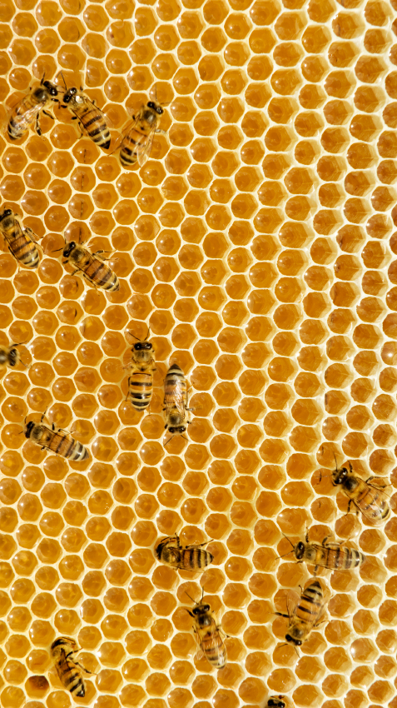
The Reticulum: The Honeycomb
Connected to the rumen
Helps filter heavy foods
Fun fact: cows might eat all sorts of things (even nails!) that can get stuck in the reticulum.

Slide 7
The Omasum: The Sponge
Has “leaves” of tissue that look like pages in a book
Helps take nutrients and water out of feed

Slide 8
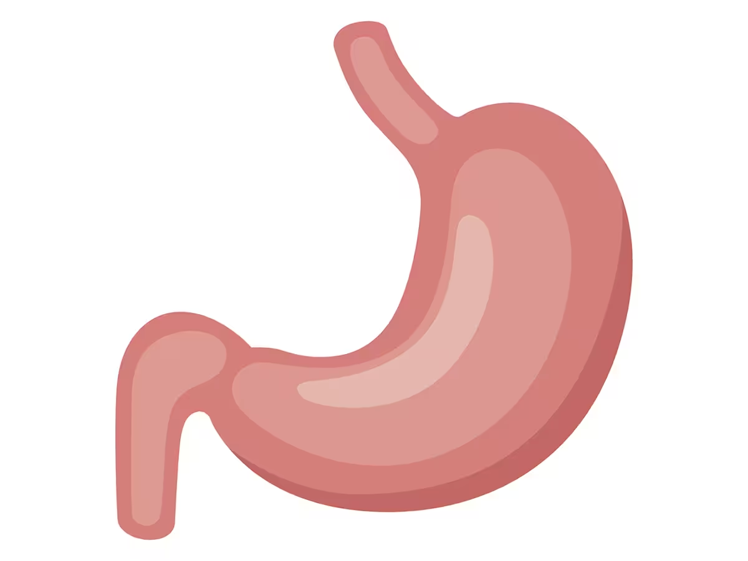
The Abomasum: The True Stomach
Similar to our stomachs!
Breaks down food with acid and enzymes

Slide 9
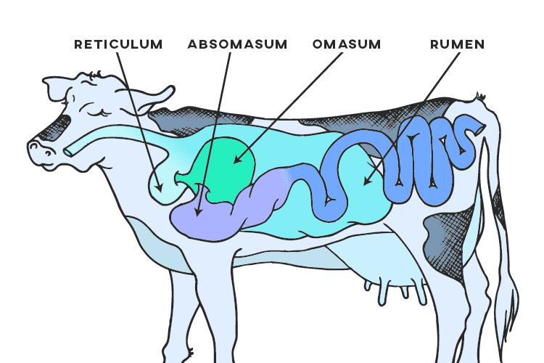
Review
With a partner, briefly note what each compartment does.

Slide 10
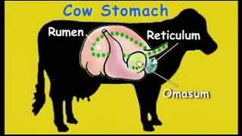
Video

Slide 11
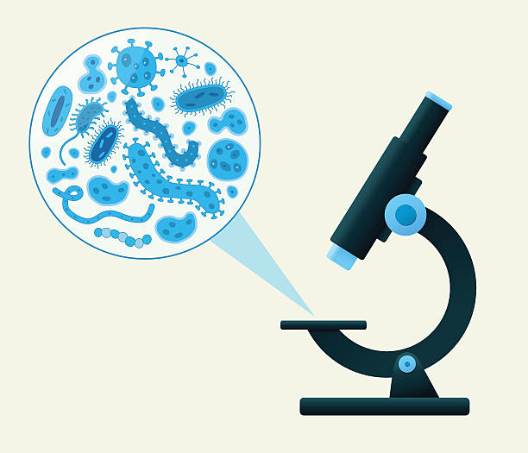
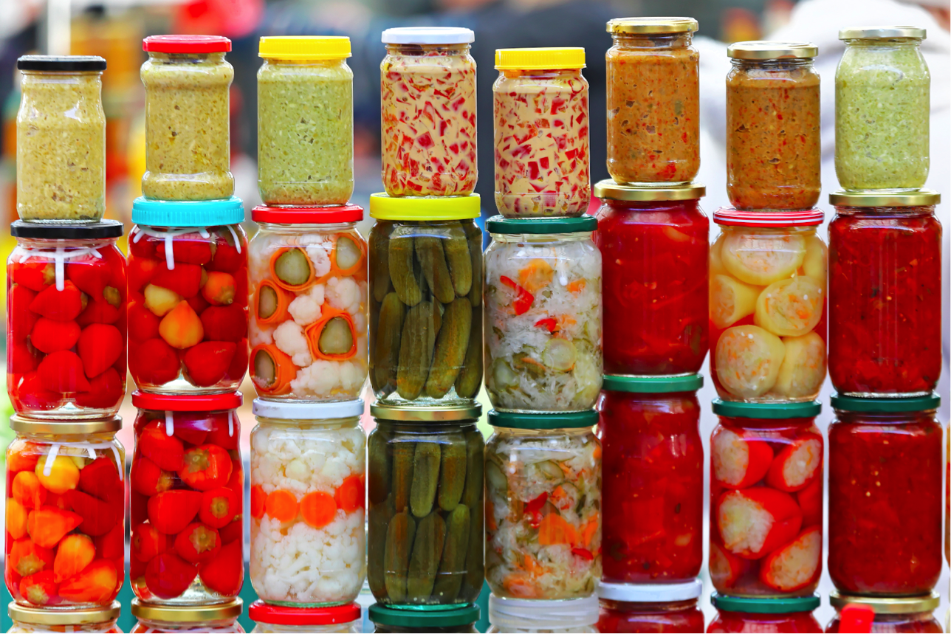
So.. how does the cow get nutrients?
Remember the rumen? This large container is full of microscopic organisms called microbes! It sort of acts like a fermenter - like how cabbage can become sauerkraut, or how milk becomes yogurt.
Have you ever tried fermented foods?

Slide 12
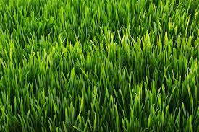
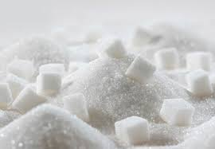
The Job of Microbes
Microbes live in different places in different animals.
They live in the rumen in cows and love to breakdown all of the grass and grain that cows eat.
They turn the grass into essential nutrients and vitamins the cow needs
The main energy source in the cow are called Volatile Fatty Acids - made from the sugars in the plants they eat!

Slide 13
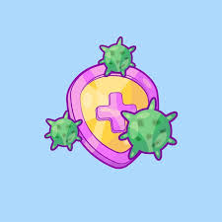
Microbe Army
Microbes line the rumen, creating an extra layer of protection and defend against invaders like viruses and parasites
They can also activate your immune system if they sense a serious threat
Brainstorm different things your immune system
protects you from.

Slide 14
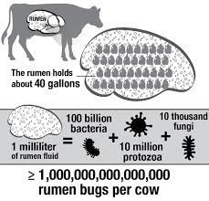
*burp!*
The microbes in the cow love a varied diet and lots of time to ferment and digest it.
As the microbes break down the food, they produce gas.. A lot of it.
Basically, the happier the microbes are, the more gas they produce.
What are foods for people that can make us gassy?

Slide 15
Why does this matter?
Microbes make lots of gas, like carbon dioxide and methane, that cows have to burp out so that it doesn’t build up in their bodies.
Cows have lots of microbes in their rumen, and there’s lots of cows (almost a billion!) in the world, so…
Can you think of ways that the digestive system of a cow would affect the world around you?

Slide 16
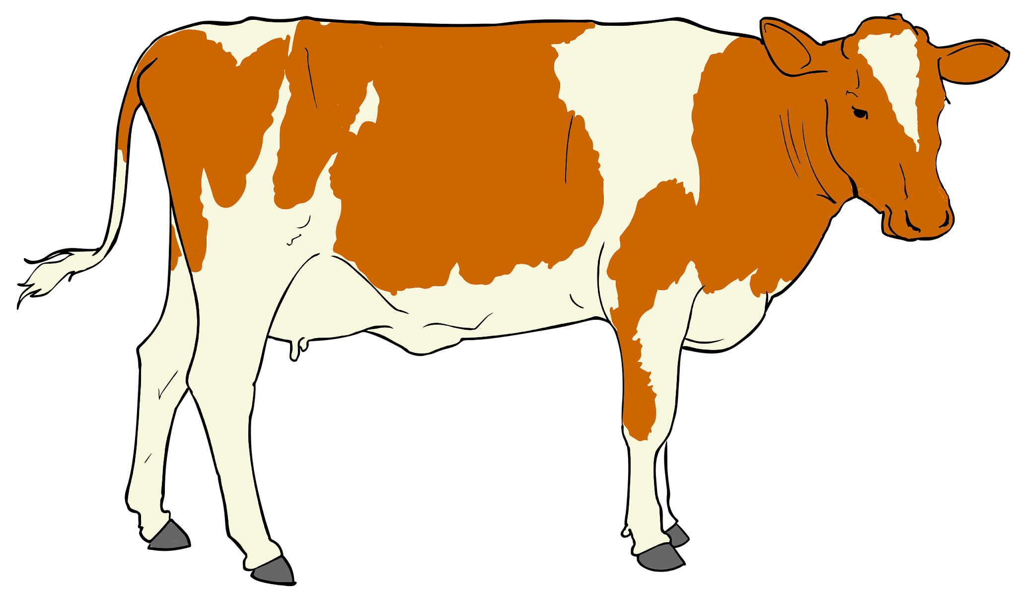
GLOBAL CLIMATE CHANGE
As you might already know, carbon dioxide and methane are two of the biggest contributors to climate change in the world!
Since there’s so many cows, making so much gas, that means cows are a big contributor to greenhouse gas production!
(They’re not the biggest, but they still make an impact!

Slide 17
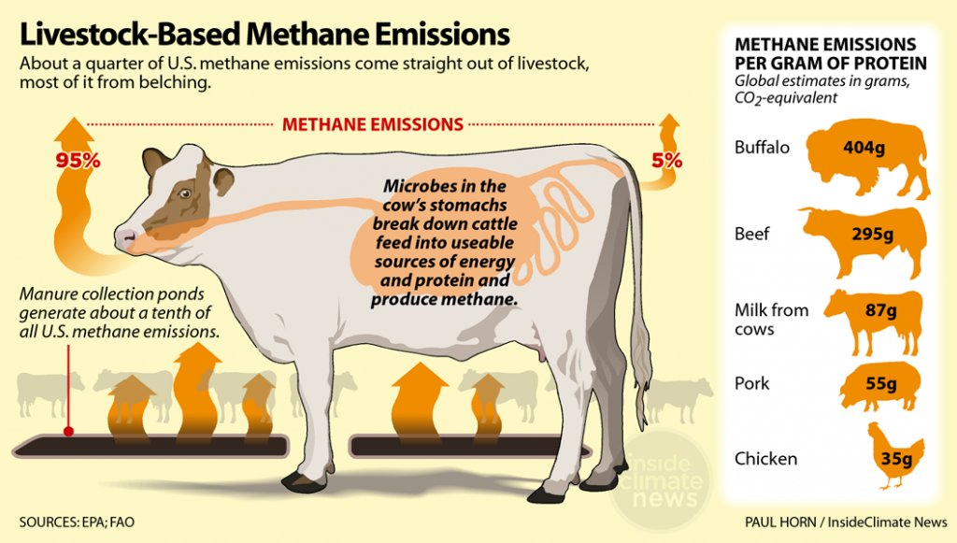

Slide 18
